Slide 1
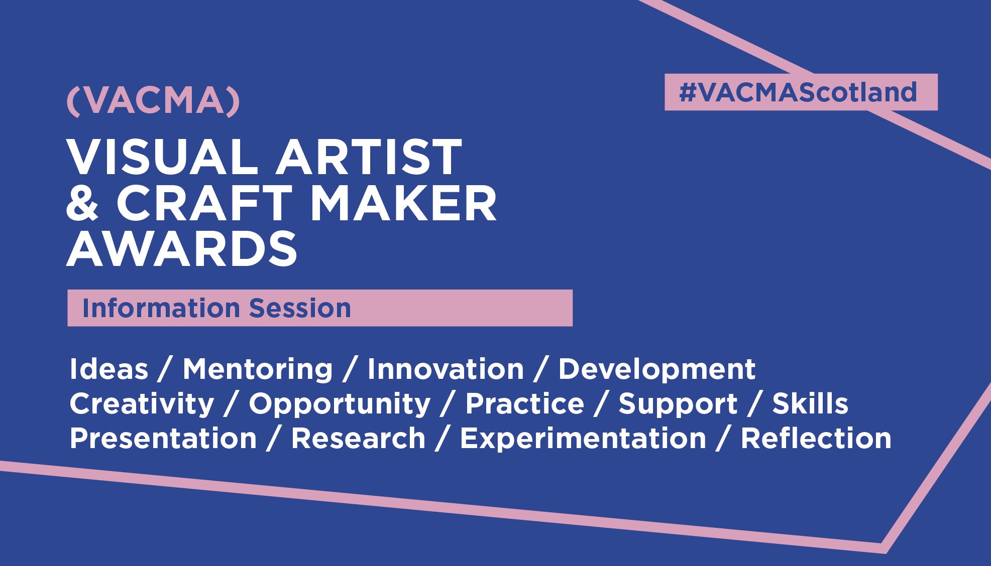
VACMA Information Session 2024

Slide 2
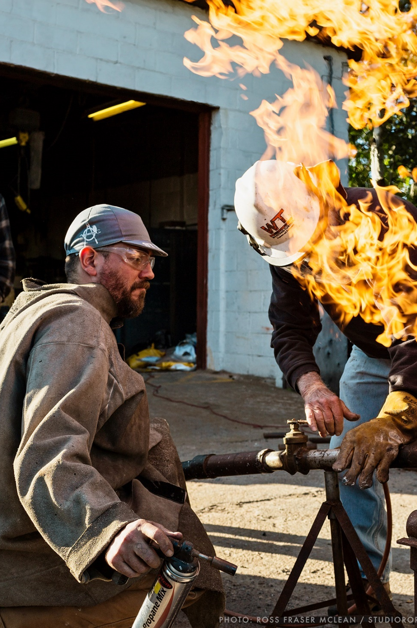
About Creative Scotland
Creative Scotland is the public body that supports the arts, screen and creative industries across all parts of Scotland on behalf of everyone who lives, works or visits here.
Image Credit: Scottish Sculpture Workshop. Photo by Ross Fraser McLean/Studio RoRo

Slide 3
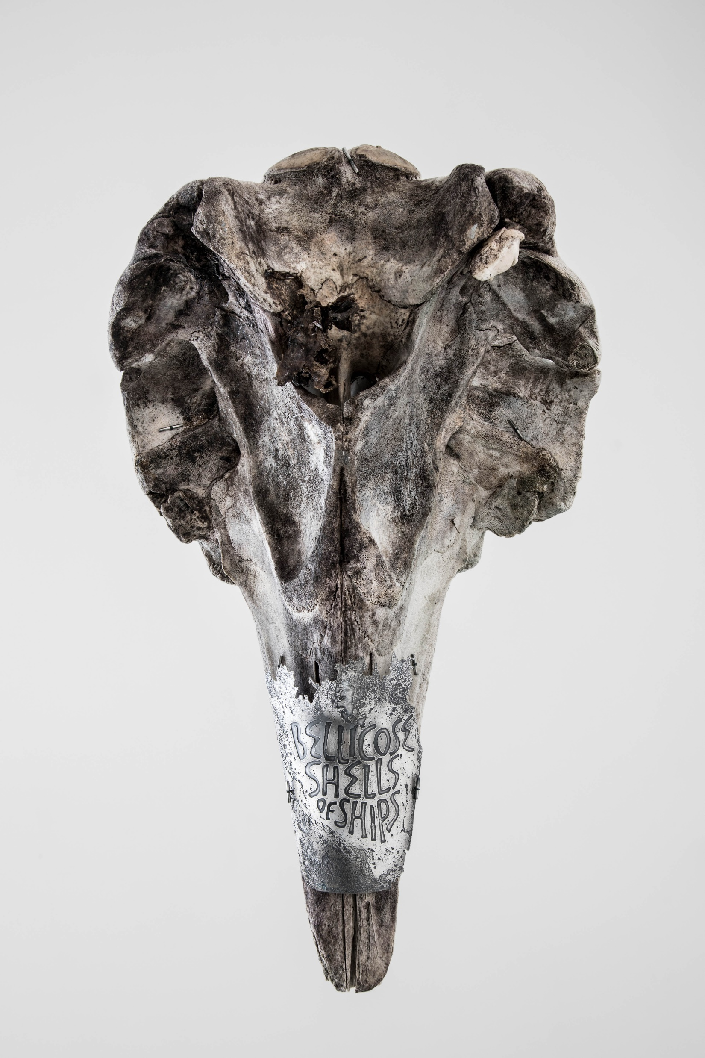
About
Creative Scotland
Creative Scotland are:
a funder
an advocate
a development agency
an organisation that seeks to influence others to increase opportunity and maximise the impact our resources can offer
Image: Cuvier’s Beaked whale skull with etched silver by Mhairi Killin, words by Miek Zwamborn, calligraphy by Susie Leiper. Credit Mhairi Killin, photography Sarah Darling

Slide 4
Creative Scotland’s Funding
We distribute funding from two primary sources, the Scottish Government and the National Lottery.
Through this funding we manage:
Regular Funding (RFO): funding a number of organisations across Scotland
Open Funding: to support the development and delivery of creative activity and programmes of work
Targeted Funding: to support projects and partnerships to address strategic need

Slide 5
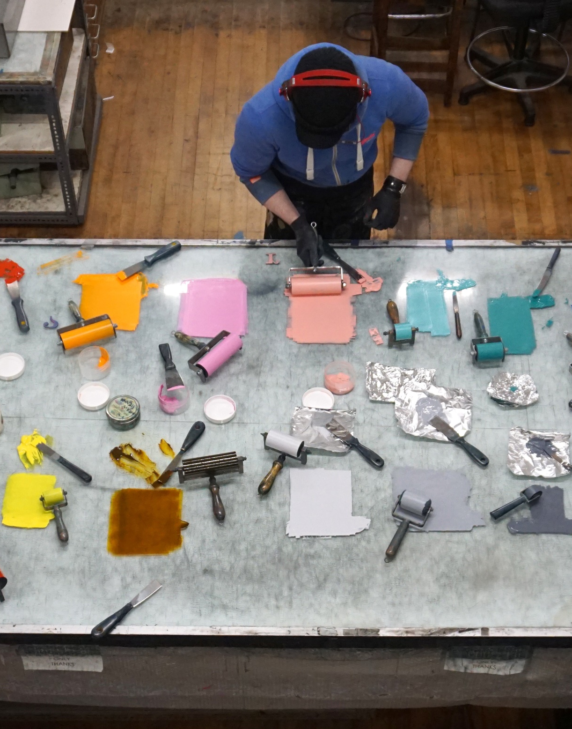
What is VACMA?
VACMA is a programme of small grant schemes designed to support visual artists and craft makers in their creative and professional development.
Image: Peacock Visual Arts. Photo Neil Corall

Slide 6
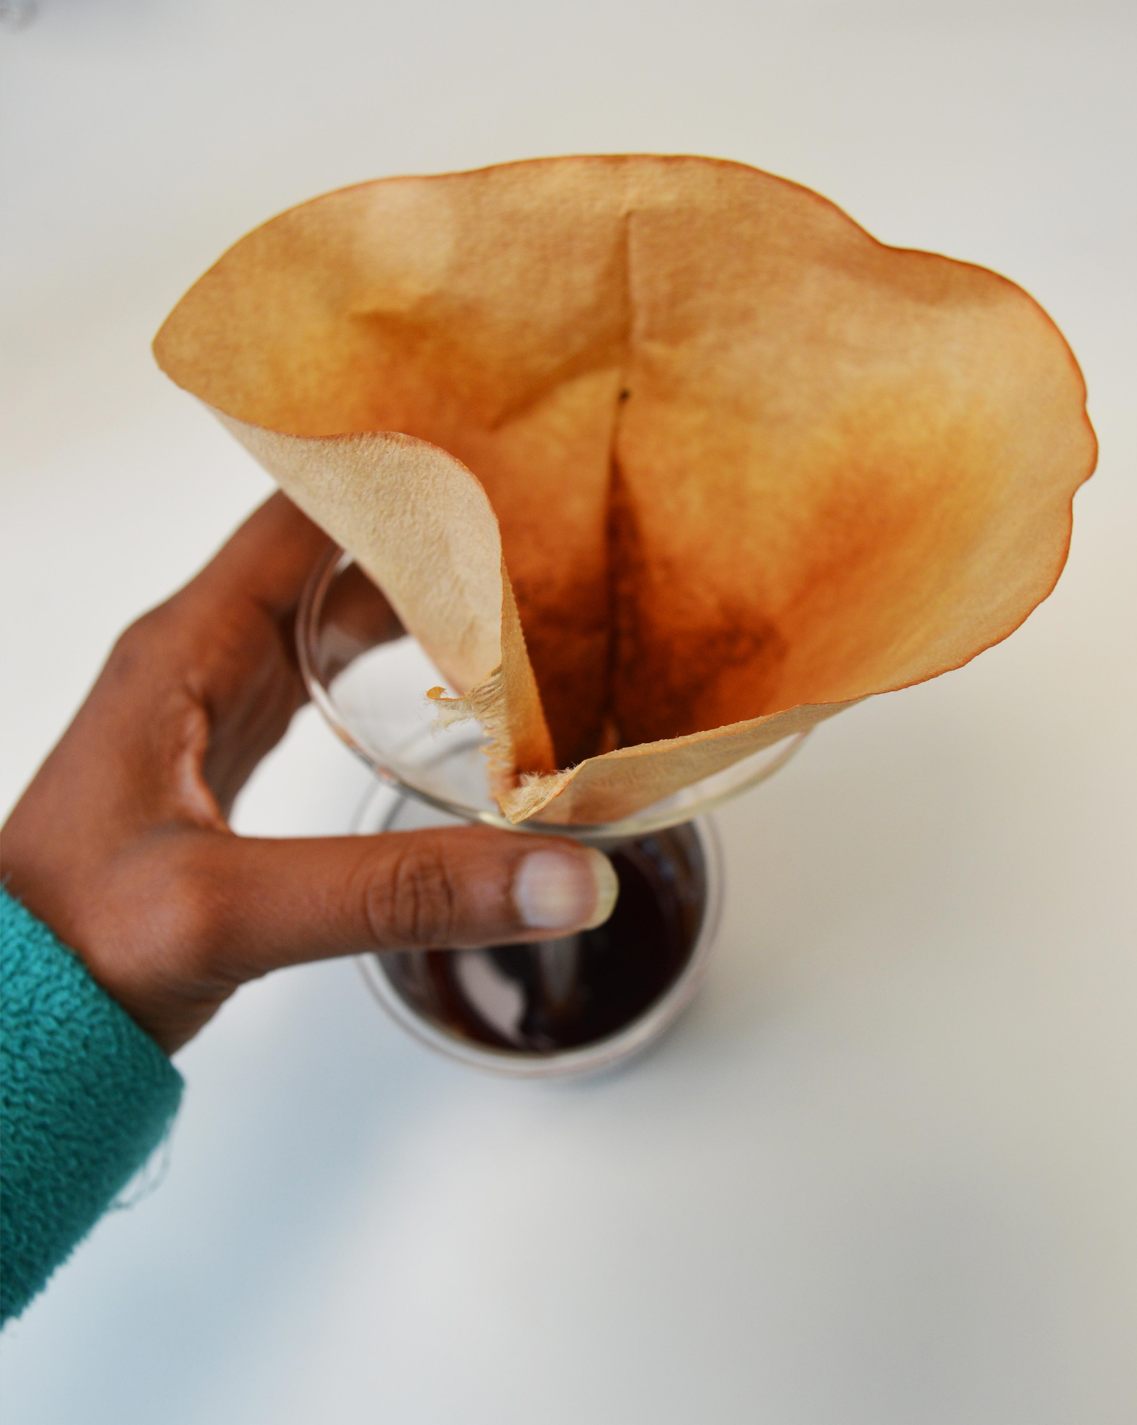
About VACMA continued
Supported by Creative Scotland through National Lottery funding, it is delivered in partnership with a range of local partners across Scotland.
The scheme currently covers 25 Local Authority areas.
Image: Pigment 1, Colours of Oban, Renuka Ramanujam, 2023. Photo by Renuka Ramanujam

Slide 7
Current Schemes
Aberdeen
Aberdeenshire
Angus
Argyll and Bute
Ayrshire (North, South & East)
Dundee
East Lothian
Edinburgh
Fife, Perth and Kinross
Forth Valley (Falkirk, Stirling & Clackmannanshire)
Glasgow
Highlands, Moray and Na h-Eileanan Siar
North Lanarkshire
Orkney
Shetland
South Of Scotland (Scottish Borders and Dumfries & Galloway)
West Dunbartonshire

Slide 8
How much can I apply for?
VACMA provides fixed bursaries of:
£500 Early-career Bursaries - for artists and makers that have been practicing for less than 5 years.
£1000 Artist Bursaries - for artists and makers who have been practicing for over 5 years.
You do not need to have studied art formally to apply.

Slide 9
What can the bursaries be used for?
The VACMA bursaries can support a wide range of activity including:
Professional training, courses and peer-to-peer learning.
Mentoring and skills development.
Testing new ideas and processes.
Researching and developing a new body of work.
Experimenting with sustainable and renewable materials, circular design and low impact processes.
Residencies that are tailored to your creative and professional development.
Equipment where there is a clear rational for how it will develop your practice and support experimentation.
Additional support towards making new work for an exhibition or presentation.

Slide 10
Criteria – what are we looking for?
Commitment to Practice
Your CV – put the newest things first and take out any non-art related activities.
Examples of work – choose your examples carefully and make sure they are of a good quality. Select recent examples that support your written application.
If you are proposing to develop work in a new medium it can help to include 1-2 examples that back this up and show some early experimentation.
Written responses – use the application form to expand on the information in your CV. This is an opportunity for you to provide more detail about your motivations and interests and to highlight any key achievements.

Slide 11
Creative Development
Have a clear reason for applying – tell us what you want to do with the bursary and how it will support you to develop your skills and ideas.
Relationship to previous work – we will want to know how it relates to what you have done before and builds on your previous experience.
Experimentation – explain the difference that it will make to your practice and the change that you want to achieve.

Slide 12
Clear Project Plan
Timeline – outline of the key stages of your project or activity. Make sure allow at least 8 weeks from the application deadline before beginning your activity.
Risk - tell us what they are and how you would mitigate them.
Letter of support – if you are applying for support with an exhibition or residency that you have been invited to do, we would expect to see a letter from the gallery or host organisation outlining their contribution.
Self-initiated exhibitions – if you are applying to put on your own exhibition, we would expect to see an appropriate plan in place for reaching audiences, including the use of accessible venues.

Slide 13
Equalities, Diversity and Inclusion (EDI)
We will also consider:
Creative Scotland and all VACMA partners are committed to supporting Equalities, Diversity and Inclusion (EDI).
We do not expect projects to have an EDI focus, however we do expect applicants to consider and respect these principles when designing their activity.
If you have experienced barriers to progressing your practice you can tell us about this. The Panel will take this into consideration when making decision about who to fund.
When faced with high demand, we may prioritise support to newer applicants and those that have faced barriers to progressing their practice.

Slide 14
Environmental Sustainability
It is also a priority for Creative Scotland and VACMA partners to support and encourage environmental sustainability.
While we do not expect projects to have an environmental focus, we do ask that applicants consider the environmental impact of their activities and explain the steps they are taking to mitigate this impact.
VACMA can support artists and makers to explore new ways of making. For example, experimenting with sustainable and renewable materials, circular design and low impact processes.

Slide 15
Budget
As the bursary levels are fixed, you do not need to provide a breakdown of the costs involved. You should however make sure that your activity is feasible within the level of bursary requested.
Partnership income is not a requirement of the fund. However, if your project or activity costs more than the bursary amount you will need to tell us where the rest of the income is coming from.
VACMA is funded by the National Lottery through Creative Scotland with a range of partners across Scotland. As such it cannot be used as partnership funding for any other Creative Scotland funding programmes.
If you or a key collaborator in your project are d/Deaf, disabled, neurodivergent or living with chronic illness you can request support with Personal Access Costs that are associated with the delivery of your activity.

Slide 16
Personal Access Costs
Personal Access Costs are costs related to your own access needs, and/or the access needs of any key collaborators involved in your project e.g. a mentor or tutor.
You can request Personal Access costs if you are d/Deaf, disabled, neurodivergent, living with chronic illness, mental illness or hold caring responsibilities.
Personal Access Costs are separate to your bursary request. This to ensure that all applicants can spend the full bursary amount on their creative and professional development.
Examples of eligible costs include a BSL interpreter, specialist equipment or software, a personal assistant for disabled person and one-off or short-term childcare costs.
You can tell us if you require personal access costs in the application form.

Slide 17
How to Apply
Make sure you read the fund Guidelines before applying.
Fill in the Application Form for your local area. You will find this on your local partners website.
Submit your completed application for before the deadline. Make sure you include:
  Your CV
  Examples of work
  Equalities Monitoring Form
  Letters of confirmation/support (where relevant)
If you identify as D/deaf, hard of hearing, disabled or living with chronic illness, mental illness or neurodivergence (such as dyslexia, autism, ADHD) you can request access support.
Access support contributes to costs for services to help applicants overcome barriers to applying for funding.

Slide 18
What happens after I submit my application?
Applications go through an initial eligibility check. All eligible applications then go to a panel meeting where decisions are made on who is supported.
Panels usually includes representatives from the local partner organisations and arts professionals, including local artists and makers.
The panel will review your written responses and supporting material against the fund criteria.
Panels will only use the application material to make decisions. They will not bring prior knowledge about you or your work into the decision-making process. We call this evidence-based decision making and it is designed to ensure that every applicant is treated fairly.
You will receive a decision within 8-weeks of the deadline.

Slide 19
What if I am unsuccessful?
If you are not successful, please take time to reflect on the feedback given or ask for feedback if available.
You may have just missed out on receiving funding due to poor images or lack of clarity. Being turned down is not necessarily a comment on the quality of your work but rather the strength of your proposal compared to others being considered.
We have had experience of a good number of people being turned down in one round and then successfully reapplying with a stronger and more focussed application having considered feedback from the panel.

Slide 20
Deadlines
Tuesday 22 October 2024 at 5pm
Tuesday 4 February 2025 at 5pm
Please check with your local scheme to see which deadline(s) they are running.

Slide 21
Other sources of information and advice
Scottish Artists Union: www.artistsunion.scot
a-n The Artists Information Company: www.a-n.co.uk
Artquest: www.artquest.org.uk
Craft Scotland: www.craftscotland.org
SCAN: www.sca-net.org
Applied Art Scotland: www.appliedartscotland.org.uk
Illustrated Freelancers Guide: www.creativescotland.com/resources/professional-resources/guidance-and-toolkits/the-illustrated-freelancers-guide
Scotland’s Workshops: www.scotlandsworkshops.com

Slide 22
Further information and support
For questions regarding your eligibility, the application process, guidance or application form, please contact your local scheme.
A full list of participating partners and links to the individual schemes
can be found at www.creativescotland.com/vacma
If you have a general enquiry about VACMA or any other Creative Scotland funding programme, please contact Creative Scotland’s Enquiries service. You can do this by email, through our website or social media.
Email: enquiries@creativescotland.com
If you are a D/deaf BSL user, you can access our services with the Contact Scotland-BSL programme. Go to: www.contactscotland-bsl.org for more information.

